Slide 1
Automatic Target Scoring
Project Presentation
-- Ninad P. Chaudhari

Slide 2
Problems at a glance.
Identify the Target.
Identify the position of bullet.
Identify the position of bullet wrt. Some point
Tackle Projective & Scaling transformations.
Triangulate position.
Deduce score.

Slide 3
Identify the Target
Should be done Manually.
No Solution proposed.

Slide 4
Identify Bullet location
Use Green background. Then use subtraction to get approx. hole
Insert a “shell” in the hole, Then get green pixels of known diameter.
Improvement : Try to fit a circle of known dimensions in the found hole.

Slide 5
Approach 1 – Find Every Ring – Not implemented
Find All the circles in target, Then find the approx. location of the bullet
Assign the score of ring with closest proximity.
Use diameters of any 2 rings for triangulation hence manage scaling
If we use Hough, it will not find anything unless the image has exact circles !! Hence we solve the problem of projection.
Problems – too expensive
Hough is very unforgiving.
Proximity function necessary

Slide 6
Approach 2 – Find 1 Ring
Find 1 ring using Hough, Find the 3-10Dark part, use it to triangulate the scaling factor.
Find Bullet location wrt the center of the 3-10Dark region center.
Use distances to get score.

Slide 7
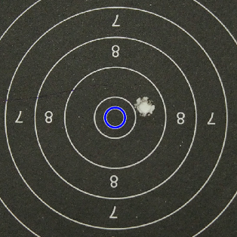
Hough for each ring?

Slide 8
Approach 3 –Find Dark region and use Shell insert
Find 3-10 Dark region. Get its center and diameter.
Find the Bullet insert, get its center and diameter.
Use the ratios of diameters, (both of them are known in physical world) to get scaling factor.
Use method of distances between corners of target to know if the target has projection error.

Slide 9
Approach 4 – Use contours. – Partially implemented.
Get contours.
Find centroids,
Use the distance between corners for triangulation.
projection => handle by distance between corners.
Scaling, reject the image if more then 2 circles are found.

Slide 10
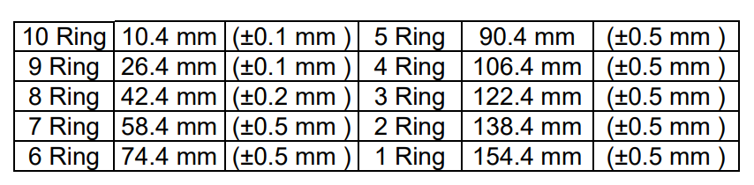
Target Specifications
Inner Ten = 5 mm (±0.1 mm).
Black from part of 3 to 10 rings = 112.4 mm (±0.5 mm).
Ring Thickness: 0.2 mm to 0.3 mm.

Slide 11
Mobile Development
Used the Java Wrapper.
Android NDK setup and used, but latest build breaks it for me.

Slide 12
Lessons Learnt
Avoid optimization hell.
Stick to one approach and stick to it.
Think on all problems before solving any one of them? Maybe?
Understand the problem completely first.

Slide 13
Thank you

